Slide 1
Flavored Dark Matter: Direct Detection and Collider Signals
Z. Chacko
University of Maryland, College Park
P. Agrawal, S. Blanchet & C. Kilic

Slide 2
Introduction

Slide 3
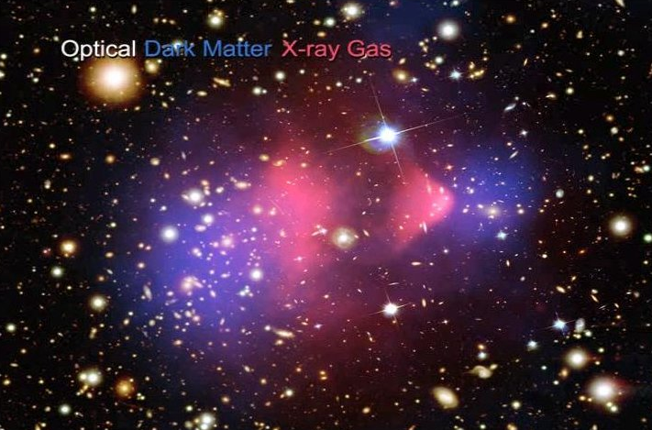
It is now well established from astrophysical and cosmological
observations that about 80% of the matter in the universe is made up
of non-luminous, non-baryonic dark matter.
However, the nature of the particles of which dark matter is composed
remains a mystery.

Slide 4
The SM quarks and leptons (Q, U^{C}, D^{C}, L, E^{C}) each come in 3
different copies or `flavors’. Could the dark matter particle $χ$ also
come in 3 copies carrying flavor quantum numbers?
Examples of flavored dark matter are sneutrino dark matter in
supersymmetry and Kaluza- Klein neutrino dark matter in theories
of universal extra dimensions.
The SM has an approximate [U(3)]⁵ flavor symmetry acting on the
matter fields. This symmetry is broken by the SM Yukawa couplings
that generate the quark and lepton masses.
To incorporate 3 flavors of dark matter we extend the [U(3)]⁵
symmetry of the SM to [U(3)]⁵ $×$ U(3)$χ$, if $χ$ is a complex field. If $χ$ is real we extend the symmetry to [U(3)]⁵ $×$ O(3)$χ$ .

Slide 5
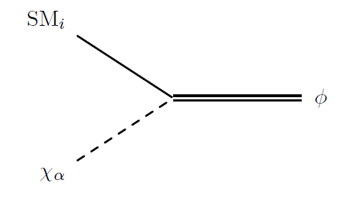
Renormalizable contact interactions between the SM matter fields
and the dark matter fields $χ$ , if present, must take the form
This interaction could either preserve the [U(3)]⁵ $×$ U(3)$χ$ flavor
symmetry, or break it, in analogy with the SM Yukawa couplings.
If the flavor symmetry is to be preserved, the mediator$φ$ must
transform under both the SM and dark matter flavor symmetries.

Slide 6
We will focus on the case when this interaction breaks the flavor
symmetry, and the mediator $φ$ is a flavor singlet.
If the SM field that $χ$couples to above is a lepton, the different
dark matter flavors are associated with the lepton flavors. We refer to this scenario as `lepton flavored dark matter’.
Alternatively, the SM field that $χ$couples to may be a quark. We
refer to this possibility as `quark flavored dark matter’.

Slide 7
Another class of theories are those where direct couplings of dark
matter to the SM matter fields are completely absent.
Instead the only contact interactions between $χ$ and the SM fields
are to the W, Z or Higgs.
These interactions can naturally preserve the [U(3)]⁵ $×$ U(3)$χ$
flavor symmetry.

Slide 8
Closely related to this are theories with interactions of exactly the
same form, but where dark matter instead couples to a new scalar or
vector boson $φ$ which mediates interactions with the SM fermions.
In this framework dark matter is not associated with either quark or
lepton flavor. We refer to this as `internal flavored dark matter’.

Slide 9
Lepton Flavored Dark Matter

Slide 10
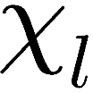
Lepton flavored dark matter is associated with vertices of the form
electrically
charged
The fact that the SM flavor symmetries are not exact naturally leads to a splitting of the states in the dark matter multiplet, with the lightest state constituting the observed dark matter.
Any quantum number that keeps the dark matter stable will carry
over to $φ$. Therefore $φ$ cannot decay entirely into SM states.
Any symmetry that keeps dark matter stable will also ensure that
lepton flavor violating processes only arise at loop level.

Slide 11
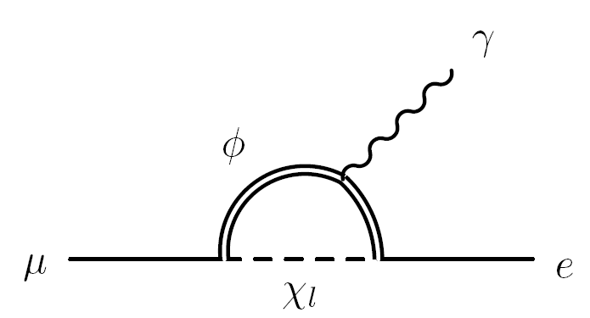
At one loop level, these interactions can give rise to lepton flavor
violating processes, such as μ → e γ.
The bounds are avoided if the mixing between the different flavors
is small, or alternatively if the couplings of dark matter are weak.
If $χ$ is to be a thermal relic, its interactions cannot be weak.
Mixing will be small if the lepton sector respects `minimal flavor
violation’ (MFV), up to effects of the small neutrino masses.

Slide 12
A direct detection signal is generated by dark matter scattering off
nucleons via a lepton loop.
Focus on the scenario where $χ$ is a Dirac fermion and $φ$ is a scalar.
These diagrams give rise to charge-charge, dipole-charge and
dipole-dipole type interactions. In general the charge-charge
contribution dominates.

Slide 13
For thermal relic dark matter, the predicted rate is close to current
limits set by the Xenon 100 collaboration.
Electron flavored dark matter
Tau flavored dark matter
thermal relic prediction
current limit

Slide 14
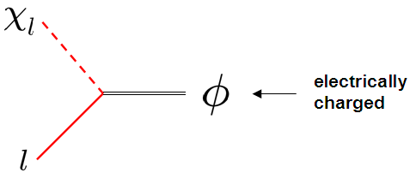
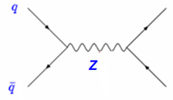
How can we search for lepton FDM at colliders?
The fundamental vertex is
The particle φ can then be pair produced through the photon or Z.
φ
φ*

Slide 15
The nature of the signals is determined by how the two φ’s decay. For
concreteness, consider MFV motivated framework where masses of
χ_{e} , χμ are equal, and greater than mass of χ_{τ} , which is dark matter.
Then each φ can decay either through a long chain, or through a
short chain.

Slide 16
Events with two long chains are the most promising.
A signal event will therefore involve at least four isolated leptons
and missing energy.

Slide 17
Quark Flavored Dark Matter

Slide 18
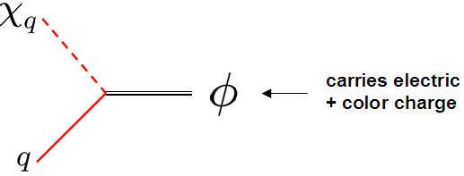
Quark flavored dark matter is characterized by the vertex
Once again, the fact that the SM flavor symmetries are not exact naturally leads to a splitting of the states in the dark matter multiplet $χ$. The lightest state constitutes the observed dark matter.
As before, any symmetry that keeps dark matter stable will serve to
postpone flavor violating effects to loop level.

Slide 19
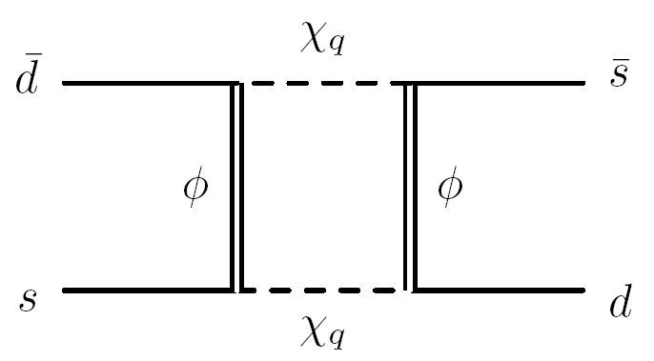
These interactions will give rise to mixing between the neutral kaons
at the one loop level.
These and similar bounds can be avoided provided the couplings of
the quarks to dark matter respect MFV.
Then a GIM mechanism analogous to the one in supersymmetric
theories comes into play, and protects against flavor violation.
Alternatively, flavor bounds are satisfied if dark matter couplings to
SM are small. Not consistent if $χ$ is a thermal relic.

Slide 20
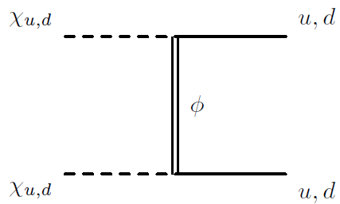
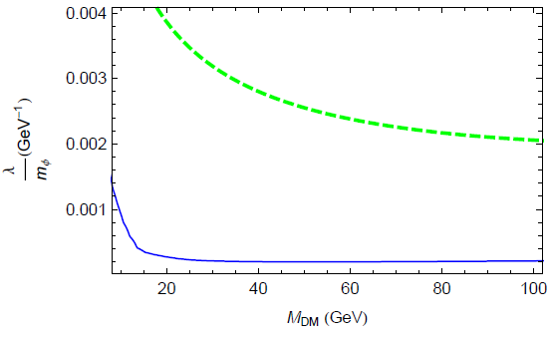
The leading contribution to direct detection depends on the flavor
that constitutes dark matter.
If dark matter carries up or down flavor, there is a tree level diagram
that contributes to scattering.
This is severely constrained. Thermal dark matter is excluded.
thermal relic prediction
current limit

Slide 21
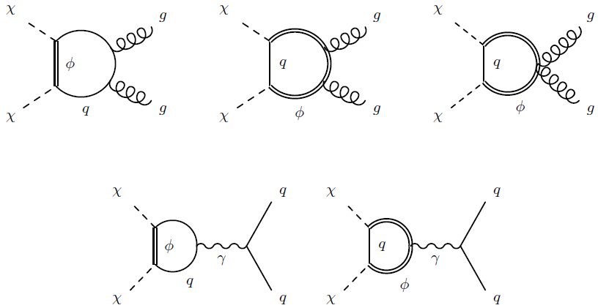
If dark matter carries top or bottom flavor, the leading contributions
arise at one loop. The photon exchange contribution dominates
over effects arising from scattering off gluons.
The predicted cross section is within reach of current experiments.

Slide 22
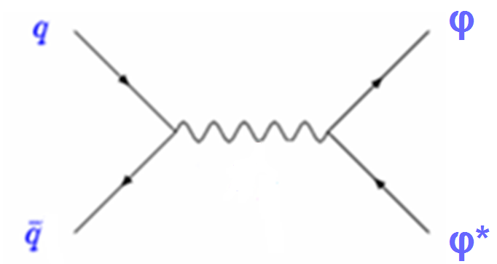
How do we search for quark FDM at colliders?
The fundamental vertex is
Since φ is colored, it can be pair produced through off-shell gluons.
g

Slide 23
The nature of the signals is again determined by how the two φ’s
decay. We work in MFV framework where the masses of χ_{d} and χ_{s}
are nearly equal, and more than mass of χ_{b}, which is dark matter.
Then each φ can decay either through a long chain, or through a
short chain.
$$χb$$
$$χb$$

Slide 24
As before, two long chains are the most promising.
The signal is 6 jets, including 2 b-jets, and missing energy.
Relies heavily on the b-tagging efficiency. Significant backgrounds
from t t-bar + jets and b b-bar + jets.

Slide 25
Internal Flavored Dark Matter

Slide 26
Internal flavored dark matter is associated with vertices of the type
electric and
color neutral
Unless these or other interactions violate the (internal) dark matter
flavor symmetry, the heavier dark matter flavors will be stable.
This scenario is not constrained by SM flavor bounds, unless the
couplings of the mediator $φ$ to SM matter fields violate flavor.
The direct detection signal depends on how $φ$ couples to the SM
matter fields, and therefore varies from model to model.
The collider phenomenology is very sensitive to if and how the
heavier dark matter flavors decay, and is also model dependent.

Slide 27
Tau FDM at Colliders

Slide 28
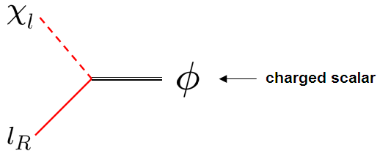
We now study in detail the prospects for detecting a specific model
of tau flavored dark matter at the LHC.
We take $φ$ to be a scalar and $χ$ to be a Dirac fermion. We also choose $χ$ to couple to right-handed, rather than left-handed, SM
leptons.
We also choose $χ$ not to carry weak charge. Its SM quantum
numbers are then completely fixed. It is completely SM neutral.
The SM quantum numbers of $φ$ are then also completely fixed. It is
charged under both the photon and the Z.

Slide 29
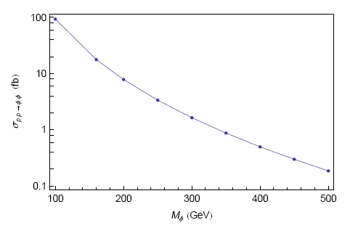
Then, for a given $φ$ mass, its production cross section at the LHC is
completely fixed. It is p-wave suppressed since $φ$ is a scalar.

Slide 30
For concreteness, we work in an MFV motivated framework where the
masses of χ_{e} and χμ are very nearly equal.
Focus on events with two long chains.
Signal events involve at least four leptons and missing energy.

Slide 31
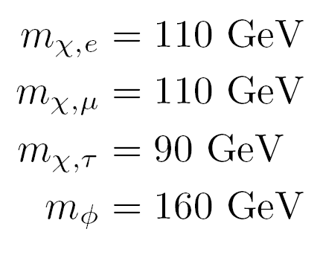
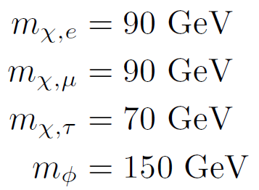
We choose two benchmark spectra.
We perform a full collider study, incorporating detector effects.

Slide 32
There are several SM backgrounds, and removing these will require
cuts. We go through these one by one.
(l⁺ l⁻ ) (l⁺ l⁻)
Each pair of leptons could arise from decay of an on-shell Z, either
directly, or indirectly through the leptonic decays of a pair of taus.
They could also arise from the decays of an off-shell Z or photon.
This background can be reduced by imposing a Z-veto. Also, since
the electrons and muons arising from tau decays are generally
soft, require high energy leptons, and large missing energy.
W W (l⁺ l⁻)
The production cross section for this process is relatively low, and
almost all such events can be removed by a Z-veto.
t t-bar (l⁺ l⁻)
The Z-veto significantly reduces this background. In addition, we
discard events with two or more hard p_{T} jets.

Slide 33
21
The table shows that it should be possible to distinguish these
models of tau flavored dark matter from the SM.
The first spectrum can be distinguished with about 40 fb⁻¹. The
second spectrum will require 20 fb⁻¹.

Slide 34
Conclusions

Slide 35
Dark matter could carry flavor quantum numbers, just as the quarks
and leptons do. We have studied theories where dark matter carries
flavor and has renormalizable contact interactions with the SM.
The simplest theories of this type involve lepton flavored, quark
flavored or internal flavored dark matter. Each of these possibilites
is associated with a distinct type of vertex, and has its own
characteristic phenomenology.
We have studied the collider signals of theories where dark matter
carries tau flavor. Signal events are associated with multiple leptons
and missing energy. After cuts, these theories can be distinguished
from SM.
Tau FDM can also be distinguished from simple theories where dark
matter does not carry flavor, making use of charge and flavor
correlations among the leptons in signal events.

